Slide 1
Risk Information Issues and Needs: An Overview
Synthesis paper as an output of the First Technical Workshop on Standards for Hazard Monitoring, Databases, Metadata and Analysis Techniques to Support Risk Assessment, 10 - 14 June 2013, WMO Headquarters in Geneva, Switzerland
Manuela Di Mauro, UNISDR; Maxx Dilley, UNDP
Laurence McLean and Debarati Guha-Sapir, CRED; Angelika Wirtz and Jan Eichner, Munich Re

Slide 2
Introduction
Two categories of risk information
  for calculation of the risks before disasters occur
  documenting the losses after a disaster
Describe each, then identify areas that could be improved through greater standardization
Two areas of issues and needs
  Hazard-related (can be addressed by WMO TCs)
  Non-hazard-related (other mechanism needed)

Slide 3
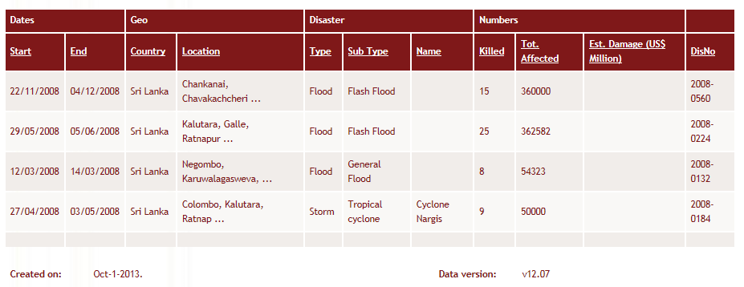
Disaster data
Example from EM-DAT, the OFDA/CRED International Disaster Database

Slide 4
Disaster data uses
Tracking loss trends over time
Identifying the geographic distribution of disaster occurrence
Obtaining breakdowns of historical losses by hazard
Assessing the impacts of losses on other variables, for example GDP
Assessing requirements for prevention, preparedness, recovery and insurance
Assessing the risks of future disasters

Slide 5
Disaster databases
Global
  EM-DAT (CRED)
  NatCatSERVICE (Munich Re)
  Sigma (Swiss Re)
Regional (2)
National (50+)
Sub-national (4)

Slide 6
Disaster data issues and needs
General
  Identification of the hazard event with which the losses are associated may or may not have been made by a recognized authority (Munich Re “peril families”), e.x. Hurricane Mitch
  Systematically collected primary loss and damage assessment data may or may not be routinely available from official sources

Slide 7
Disaster data issues and needs
Country level databases (UNDP, 2013)
  Many parameters, some with unclear definitions (“affected,” “victims”)
  Inconsistent economic valuation of physical damages and losses
  Lack of differentiation between zero (no losses) and missing values (no information)
  Attribution of losses in localities to local secondary hazards without ability to aggregate losses associated with a larger-scale, primary hazard
  Lack of application of a standardizing indexing system

Slide 8
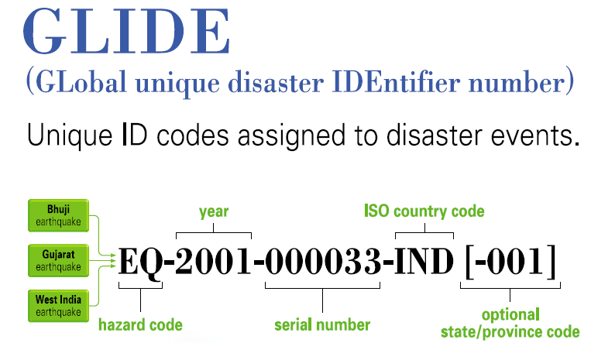
Disaster data indexing standard

Slide 9
Disaster data status
Differences from one database to another in terms of how events are classified by hazard, geo-coded, and the levels and types of associated losses and damages recorded
Lack of clear standardized data collection methodologies and definitions
Difficult to compare and cross-validate data from different databases both horizontally and vertically (i.e. between databases with global, national or local-level coverage)

Slide 10
Disaster data ideal situation
Multi-tiered system of disaster impact data collection – interoperable between sub-national, national, regional and global levels – using a harmonized set definitions and methods
Initiatives with standard-setting potential
  WMO DRR User-Interface Expert Advisory Group on Hazard/Risk Analysis
  European Commission Joint Research Centre technical recommendations for Europe

Slide 11
Why probabilistic risk assessment?
      Probabilistic risk assessment provides information on “what”, “how likely” and “how much”
      Consequences calculated by aggregating losses from different events
      Hazard and risk expressed in terms of occurrence rates or exceeding rates
      The uncertainty in the estimation of hazard and vulnerability is captured
      Possibility to compare and aggregate losses from different hazards – multi-hazard risk
Notes:
Why the probabilistic risk assessment is “on fashion” ? A deterministic risk assessment does not allow representing the full variability of the events and their actual probabilities, and does not capture the epistemic or systematic uncertainties.
The risk (as definition) has to express the probability of consequences from different events. Thus it needs to be expressed in terms of occurrence rates.

Slide 12
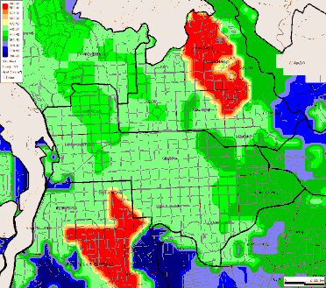
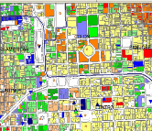

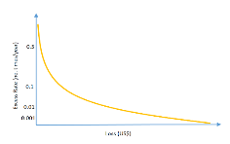
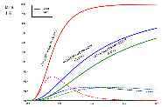
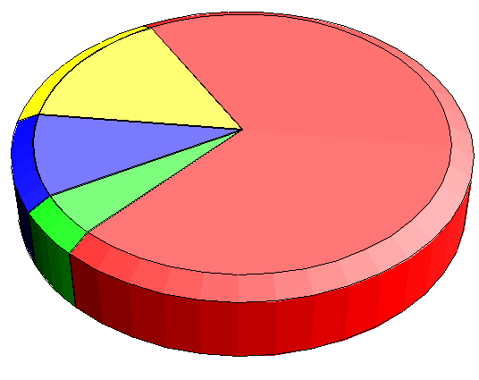
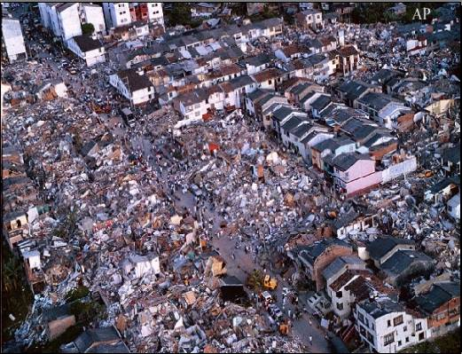
Probabilistic Risk Modeling
Hazard
Damage
Loss exceedance
Exposed assets
Economic
Human
Vulnerability
Notes:
I am going through a quick overview on the probabilistic risk assessment, mainly from the perspective of the modelling. Possibly most of what I am going through is something you are familiar with, thus I will skim through quicky and please stop me if there is anything you wish to discuss further.
Here there is a simple schematisation of the probabilistic risk modelling: that is basically the convolution of a series of hazard scenarios (probabilistically defined) and an exposure dataset, through the asset’s vulnerability (which is also defined probabilistically). Usually the uncertainty in the definition of the exposed elements is not icluded, but it could be potentially be introduced with the same technique
The damages are therefore assessed with their probability of occurrance and theri variance, from which it is posible to calculate their exceedance probability and the “loss exceedance curve”

Slide 13
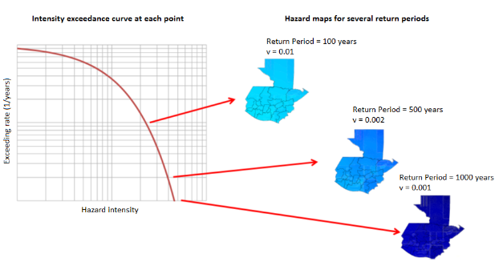
Hazard models for Risk assessment
“Hazard information” are usually used for risk assessment as input to hazard models
This is because we need to reconstruct the hazard intensity with its spatial variability and probability
From these data, a set of events with assigned return periods are modelled
<

Slide 14
Output from hazard models
The produced intensity exceedance curves are useful (and used) for dimensioning the built environment as well as designing risk reduction interventions:
  Definition of building codes
  Dimensioning of drainage systems
  Design of levees, bridges, breakwater…
  Choice of type and design of telecommunication networks
  Develop land use policies
  Acquire emergency supplies
Notes:
This curve provides the likelihood that a certain intensity is surpassed exceeded, thus it is extremely useful to design for interventions, but also to properly dimension structures so that they can withstand the hazard. Not only, but they provide information in the likelihood that the design choice to be inadequate, thus causing potential damages etc. which is an important information in terms of cost-benefit but also a potential liability issue, with political and sometime legal consequences.

Slide 15
Exposed assets
  The second part of risk assessment consists in identify and characterize assets susceptible to damage in the occurrence of hazardous events e.g.:
        Urban buildings
        Urban infrastructure
        Rural areas
        Infrastructures
        Human exposure
  Typical information needed:
        Geographical location
        Structural characteristics
        Replacement values
        Human occupation
        Socio-economic characteristics of the occupants
Notes:
Exposure identifies different types of physical entities that are “on the ground”. Exposure data include built assets but also infrastructure, agricultural and human exposure.
The exposure data should contain the physical location o the asset but also the characteristics of the asset that influence its vulnerability and enable the assessment of the damage or loss to the asset. These characteristics include

Slide 16
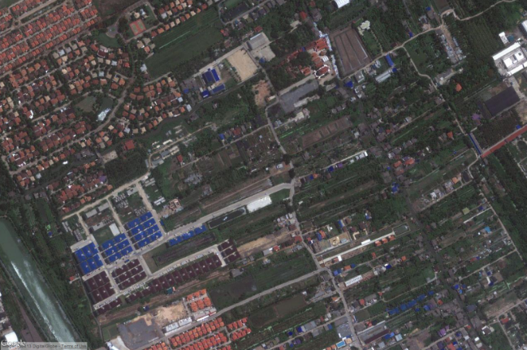
Exposed assets
examples
  Example of exposure data – high resolution
Type: Reinforced concrete
Area: 80 sqm
Occupancy: 8 people
Use: Residential
Value: 20,000 US$
Type: Precast reinforced concrete frame with masonry infill walls
Area: 200 sqm
Occupancy: 100 people
Use: Mixed (residential and offices)
Value: 100,000 US$
Notes:
16

Slide 17
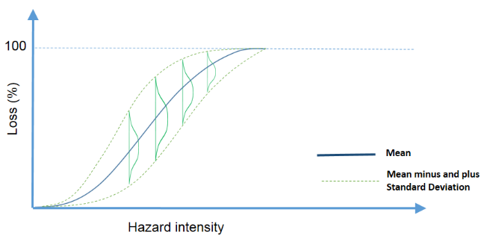
From hazard to consequence: vulnerability curves
The modelled hazard events are combined with the exposed assets through the use of vulnerability curves
The results of hazard models thus contain a spatial description of the physical quantity describing the hazard intensity according to the vulnerability curves

Slide 18
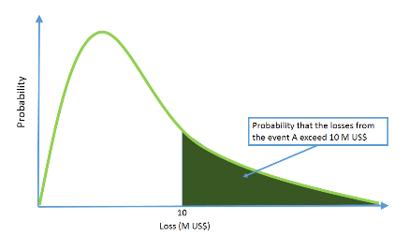
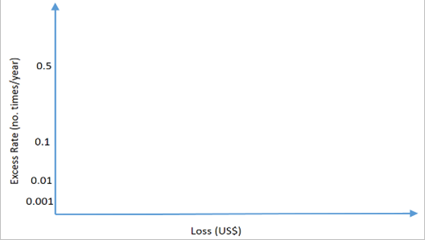
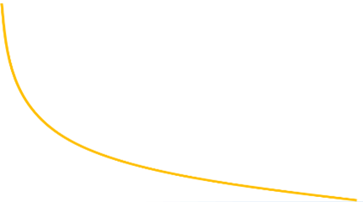
Probabilistic Risk Assessment
The risk is then calculated by combining all the events, with their probability, and the correlated losses, which will also have an associated exceedance probability
Notes:
The last element on the equation is the calculation of the risk

Slide 19
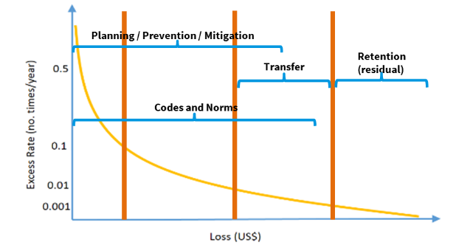
Use of probabilistic Risk Assessment
1
2
3
4
1 = high probability and low or moderate losses
2 = medium probability and moderate or high losses
3 = low probability and high losses
4 = low probability and very high losses

Slide 20
Hazard information for Risk assessment
Summary
Carrying out a probabilistic risk assessment requires a considerable amount of data that will be the input to build hazard, exposure and vulnerability
Usually, “hazard information” (e.g. from Met Offices) are used as input to hazard models
In general, it important that those input data are collected/measured, and made available to risk modelers
The hazard models cannot be replaced by punctual measures because we need to reconstruct the intensity of the hazard with its spatial variability and probability
Notes:
This curve provides the likelihood that a certain intensity is surpassed exceeded, thus it is extremely useful to design for interventions, but also to properly dimension structures so that they can withstand the hazard. Not only, but they provide information in the likelihood that the design choice to be inadequate, thus causing potential damages etc. which is an important information in terms of cost-benefit but also a potential liability issue, with political and sometime legal consequences.

Slide 21
Recommendations
Disaster data
  Improved standards for identifying and characterizing different types of hazard events
    Cascading hazards (e.g. cyclone->rain->landslide)
    Standardized definitions (e.g. different types of floods)
    Characterization (hazard-specific standards for specifying magnitude, duration, location and timing)
    Hazard event databases using a common event identification system

Slide 22
Recommendations
Disaster data
  Procedures for more systematic official designation of hazard events in real-time
    Who the designated authority is in a country
    How the designations are to be framed (i.e. hazard names, numbers or other conventions)
    How the information is made public
    How discrepancies are retroactively corrected
    Reconciliation of designations across borders during hazard events affecting multiple countries

Slide 23
Recommendations
  Disaster data
    Integration of hazard-related standards with other standards
      Indexing system for disaster events (e.g. GLIDE)
      Number and definitions of core parameters (e.g. sex- and age-disaggregated mortality, physical asset losses and damages and their economic equivalencies, etc.)
      For loss assessment and reporting (i.e. primary data collection)
      Methods for the estimation of economic losses
      Data access
      Quality control

Slide 24
Recommendations
  Hazard information for risk assessment
1. Guidelines and standards for probabilistic hazard and risk assessments
  Risk assessment is one of the key indicators of progress for the Hyogo Framework for Action
  No general indication for assessing the quality of a probabilistic hazard and risk assessment, nor for identifying the minimum requirement for such assessment
  Without such information, resources might be used to produce sub-standard or uninformative risk assessments…
  Such guidelines would require extensive consultation with various institutions.

Slide 25
Recommendations
  Hazard information for risk assessment
2. Baseline data produced, updated and made available for hazard modeling
  Baseline data, such as topographic, land cover or bathymetric data have to be systematically produced and updated, with different spatial resolutions and information on their accuracy, and made available for hazard and risk modeling

Slide 26
Recommendations
  Hazard information for risk assessment
3. Time series of hydro-meteorological data systematically collected and stored, following standardized (or quality-controlled, consistent) formats
  Time series of hydro-meteorological data (e.g. rainfall, flow discharges, wind gusts etc.) should be systematically and continuously collected, as they should cover a good temporal span to be used in the analysis.
  Data collection should follow coherent formats and method, to ensure coherence in the way the data are collected/measured (for example among stations in different sub-basins)
  Data should be collected providing an appropriate spatial coverage to enable the modelers to produce a usable description of the hazard.

Slide 27
Recommendations
  Hazard information for risk assessment
4. Data quality, resolution and uncertainty provided together with the datasets
  The input data for risk modelling should be provided with information on their quality.
  If this information is lacking or cannot be assessed, it is difficult to evaluate the uncertainty related to the input data, therefore to calculate the propagation of this uncertainty to the output.

Slide 28
Recommendations
  Hazard information for risk assessment
5. In case of flooding, post event surveys to record water depths (and possibly velocity) in different points of the affected areas
  Vulnerability curves are mostly based on laboratory experiments and validated with real data
  Recorded flood depths (and velocity, although more difficult to assess) in different point of the affected areas is extremely important to validate hazard models
  It is also important to validate/develop vulnerability curves, if coupled with the damages/losses at the same point and the physical characteristics of the damaged element

